Slide 1
Evidence Based Practice prevention measure for Pressure Ulcers: To use pressure-reducing surfaces or Repositioning schedule.
Name:
Date:

Slide 2
Objectives
By the end of this presentation, audience will:
Be in apposition of identifying Evidence Based Practice measure of preventing pressure ulcers. .Be able to understand how importance of the discussed measures to prevent Pressure Ulcers.
Be able to prevent themselves and the aged one around them from pressure ulcers.
Be able to prevent themselves and the aged one around them from pressure ulcers.

Slide 3
PICOT Question.
How does the use of pressure reducing surface by persons whose mobility has reduced over time as compared to not using the pressure reducing surfaces or repositioning schedule can decrease rate of pressure ulcers development over a period of 60days?

Slide 4
Thesis statement
The implementation of both ICU, individuals and hospitals of the use of pressure reducing surfaces and repositioning schedule will help decrease pressure ulcers development with other preventive measures such as skin care assessment and nutritional.

Slide 5
Background
Pressure Ulcers is a complication commonly affecting patients in acute, long-term and home care. It affects largely patients at intensive care and its prevalence had increased by about 28%. Pressure ulcers also called pressure injury, is a manifestation of destruction on part of skin area as well as tissues underneath as a result of pressure. It occurs in four stages.

Slide 6
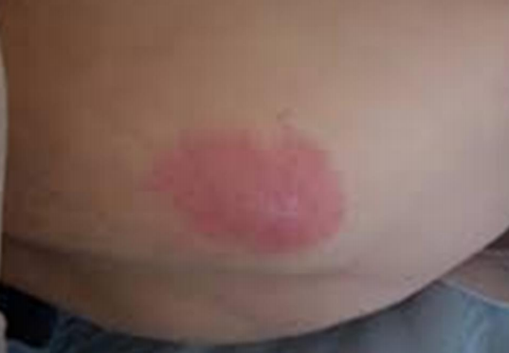
Stage 1.
Sore id not open, skin itching/burning and pain without tear or break. Skin turn red I a situation pressure is applied.
Prevent it at this stage, one can stop the pressure, reposition and the use of pillow or any other soft-material.

Slide 7
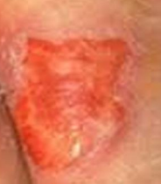
Stage 2.
The skin breaks forming an ulcers, here the wound starts to be painful. It appears like a blister and the part of the screen is swollen.
At this stage one can prevent further development by using water warm or salty to clean the wound and make it dry gently.

Slide 8
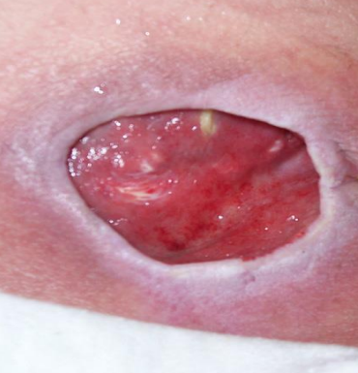
Stage 3.
At this stage, the wound is at the fat tissue, past the second layer of the skin. The wound takes the shape of a crater with pus and may have bad odor. The tissue within is black if already is dead. At this stage, the patient has to seek further medication from the physician.

Slide 9
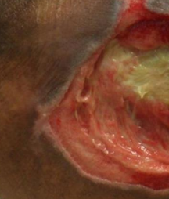
Stage 4
There wound is worse, the entire layer of the skin is out, ligament and bones might be visible.

Slide 10
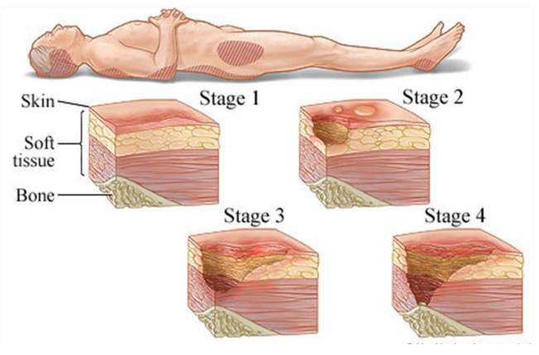
Pressure Ulcers/InJURY

Slide 11
Proposed measures
Use of pressure reducing surfaces for all patients
Repositioning at least after every Two hours.
Interventions within all 60 days.
Proper medication and nutrition

Slide 12
Methods
Meal intake documentation.
Study design
Skin assessment
Study analysis
Statistical analysis

Slide 13
Ethics considered
No harm caused to patients
Privacy
Obtaining signed forms

Slide 14
Risk factors
Old age because the skin gets thinner and fragile
Body max index.
Low body mass this leads to padding within the bones
Poor circulation of blood.
Low mental awareness.
Prolonged healing of the wound.

Slide 15
bibliography
Lyder, C. H., & Ayello, E. A. (2008). Pressure ulcers: a patient safety issue. In Patient safety and quality: An evidence-based handbook for nurses. Agency for Healthcare Research and Quality (US). Retrieved on 13th November 2020. https://www.ncbi.nlm.nih.gov/pmc/articles/PMC5136439/
Tsaras, K., Chatzi, M., Kleisiaris, C. F., Fradelos, E. C., Kourkouta, L., & Papathanasiou, I. V. (2016). Pressure ulcers: developing clinical indicators in evidence-based practice. A prospective study. Medical Archives, 70(5), 379. Retrieved on 12th November 2020. https://www.ncbi.nlm.nih.gov/pmc/articles/PMC5136439/ .
Gillespie, B. M., Chaboyer, W. P., McInnes, E., Kent, B., Whitty, J. A., & Thalib, L. (2014). Repositioning for pressure ulcer prevention in adults. Cochrane Database of Systematic Reviews, (4).Retrieved on 13th November 2020 https://www.cochranelibrary.com/cdsr/doi/10.1002/14651858.CD009958.pub2/full

